Slide 1
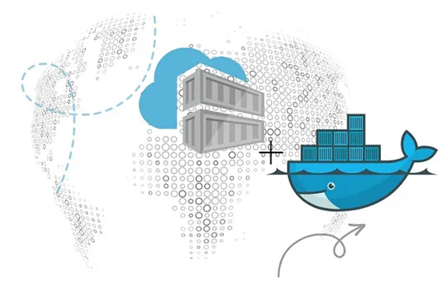
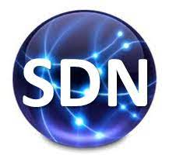
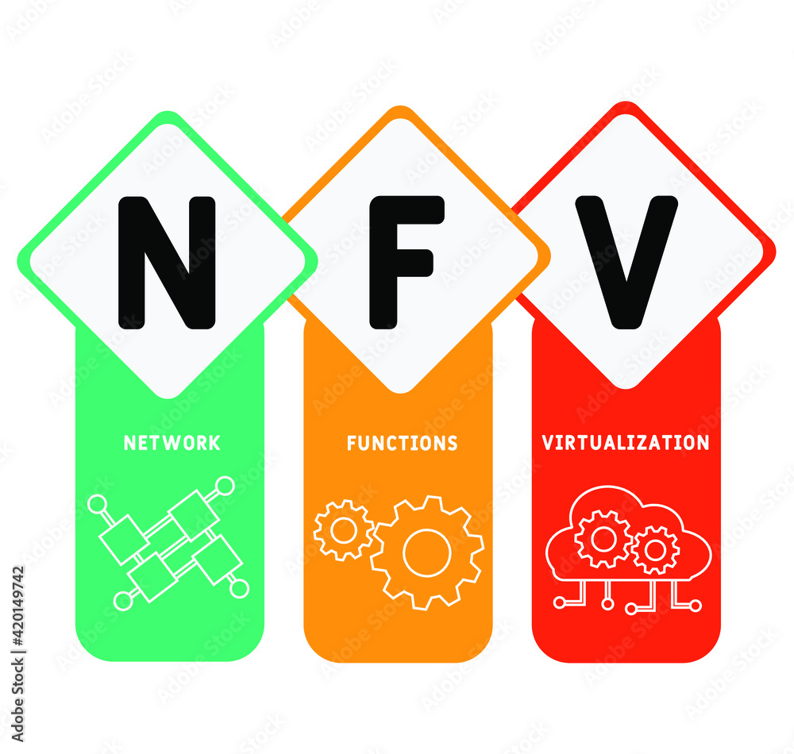
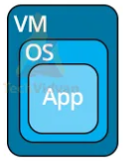
PDS
Computer Vision
Lab2-C_Deploying a Containerized Applications on Huawei Cloud
.
https://github.com/siagianp
https://www.youtube.com/@AmelOline/videos
https://github.com/amelcharolinesgn2/IoT_simulator-mqtt-NodeRed
https://github.com/amelcharolinesgn2/Cloud-Infrastructures
Notes:
https://medium.com/huawei-developers/how-can-we-run-containerized-applications-on-huawei-cloud-58e0eb033ad0

Slide 2
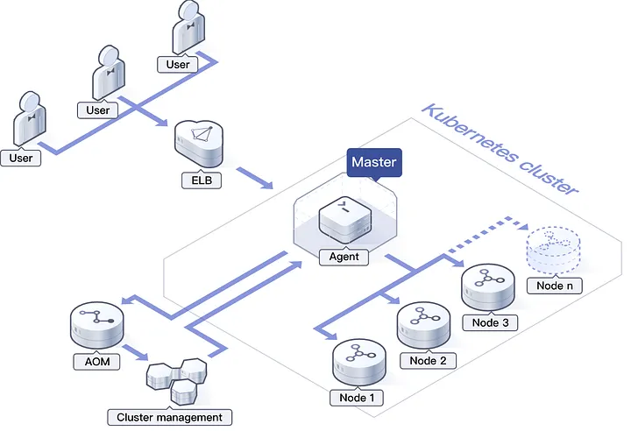
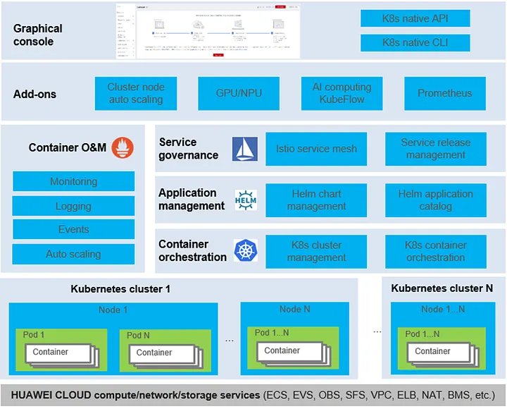
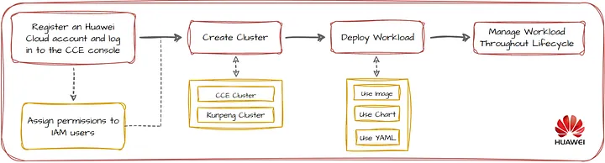
Huawei Cloud Container Engine (CCE) for Kubernetes
Notes:
https://medium.com/huawei-developers/how-can-we-run-containerized-applications-on-huawei-cloud-58e0eb033ad0
CCE Product Advantages:
High Performance: Containers can run directly on high-performance physical servers, delivering performance comparable to physical machines.
Fast Creation: Thanks to SDI technology, a physical machine can be created in 5 minutes, and a container cluster can be created in 6 minutes.
Flexible Scaling: Applications can be automatically scaled in a matter of seconds to meet fluctuating demands.
Support for Stateful Containerized Applications: CCE works closely with storage services provide highly available volumes for data persistence. This is suitable for stateful containerized applications, which save data or statuses from each session.
High Availability: High Availability is set up on both the cluster control plane and across availability zones. Graceful scale-out and scale-in of containerized applications ensure high service continuity.
Open-Source CCE is compatible with Kubernetes/Docker-native versions and incorporates the latest and greatest from the communities instantly.

Slide 3
Deploying Deep Learning Models on Kubernetes with GPU

Slide 4
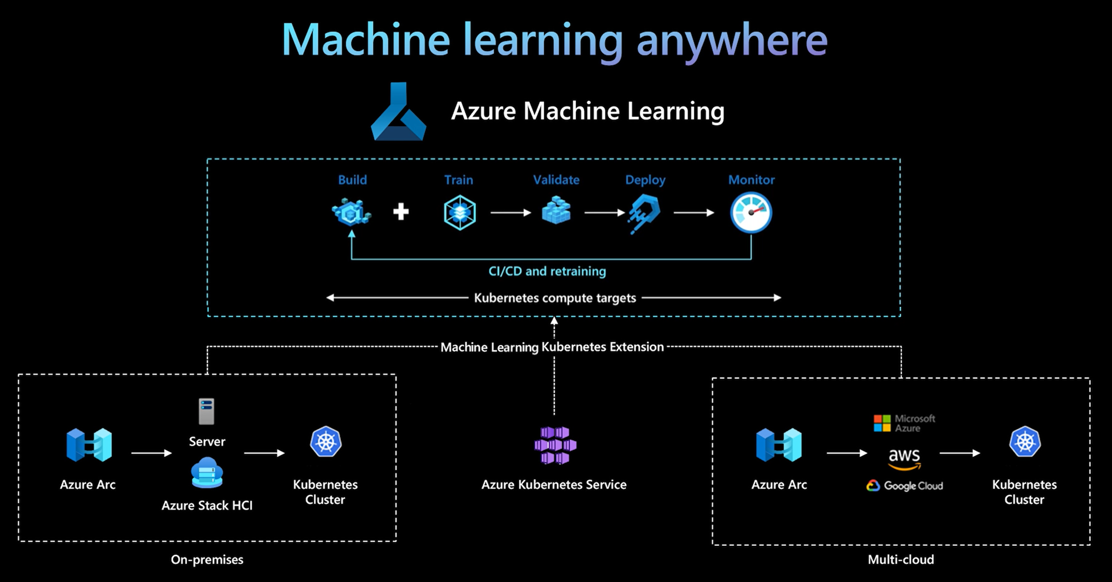
Kubernetes compute target in Azure Machine Learning
Compute | Location | Description
AKS cluster | Within Azure | With your self-managed AKS cluster in Azure, you can gain security and controls to meet compliance requirement and flexibility to manage your team's machine learning workload.
Arc Kubernetes cluster | Outside Azure | With Arc Kubernetes cluster, you can train or deploy models in any on-premises or multicloud infrastructure, or the edge.
Notes:
https://learn.microsoft.com/en-us/azure/machine-learning/how-to-attach-kubernetes-anywhere?view=azureml-api-2

Slide 5
Github
Automate provisioning in the self-service platform
Notes:
https://conferences.oreilly.com/artificial-intelligence/ai-ny-2019/public/schedule/detail/72321.html
https://s.itho.me/events/2019/k8s/1525-1605%20%E5%BC%B5%E5%AE%B6%E6%A3%A0_AI%20on%20Kubernetes.pdf
https://medium.com/hackernoon/gpus-kubernetes-for-deep-learning-part-1-3-d8eebe0dd6fe
https://github.com/alibaba/GPU-scheduler-for-deep-learning

